Slide 1
VEHICLE OWNER INFORMATION USING NUMBER PLATE DETECTION Presented by:- Supervised by:- Aman Singh 1805213008 Dr. Y N Singh Somya Pratap Singh 1805213058 Dr. Jasvant Kumar Karunesh 1805213025

Slide 2
INTRODUCTION
What is the project about?
Number Plate Recognition is a technology that uses pattern recognition to 'read' vehicle number plates. In simple terms cameras 'photograph' the number plates of the vehicles that pass them. This 'photograph' is then fed in a computer system to find out details about the owner of the vehicle. It consists of cameras linked to a computer . As a vehicle passes, program 'reads' Vehicle Registration Marks - more commonly known as number plates - from digital images, captured through cameras located either in a mobile unit, in-built in traffic vehicles or via Closed Circuit Television (CCTV).
The digital image is converted into data, which is processed through the system. In this project, we proposed a method mainly based on edge detection, OCR operation and finding rectangles in a Vehicle Image.

Slide 3
Why is this project needed?
The number of vehicles on the roads everywhere around the world is increasing with every single day and parallel to that is increasing the need to perceive those vehicles. Road accidents have been very common in the present world with the prime cause being the careless driving. The necessity to check this and to catch the perpetrator has been very essential and different methods have been used so far.
Identification of the license plate has played an important role in the past two decades in the form of electronic tolling to vehicles violating the civil codes of human societies. Further, this system can be used to manage parking facilities, to monitor unauthorized vehicles which may enter private areas, to find stolen vehicles, to control traffic volume, to issue tickets to over-speeding vehicles

Slide 4
What the project offers?
Automation: The automated recognition of number plates allows automated alerts and controls for facilities. Hence, it is a key technology for smart cities in the near future.
Analytics: The generated data can be further used for traffic flow analytics. This is particularly important to operate intelligent transportation systems, where data processing technologies can be used to improve the mobility of people and goods, demand management, increased safety, reduced traffic congestion, and manage incidents effectively.
Efficiency: The precise and fast number plate recognition doesn’t depend on any form of human input. Hence it leads to cost-efficient governance and causes a reduction in waiting times.
Convenience: It can be integrated with other IT systems to operate in an ecosystem to provide a seamless and hassle-free experience to the end-user. Hence, the technology can be used to enhance the customer experience and offer new services and products, such as automated parking payments.

Slide 5
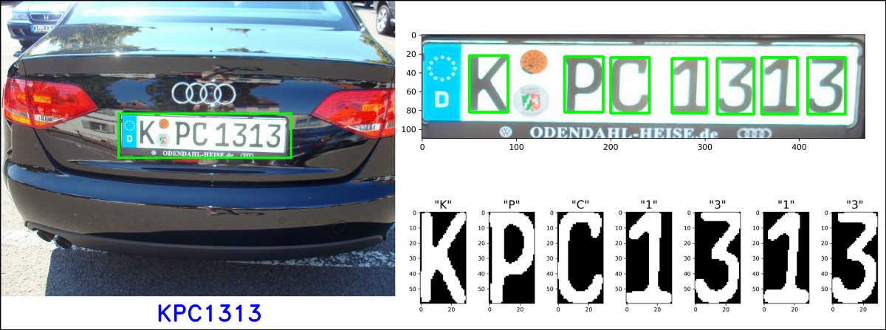
OBJECTIVE
To build and design a model that captures vehicle number plate and then extract the registration number from that and then runs it through the database to find the information about the owner of the vehicle.

Slide 6
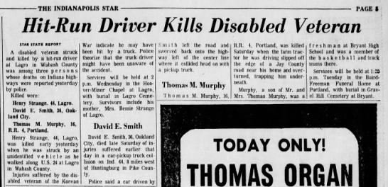
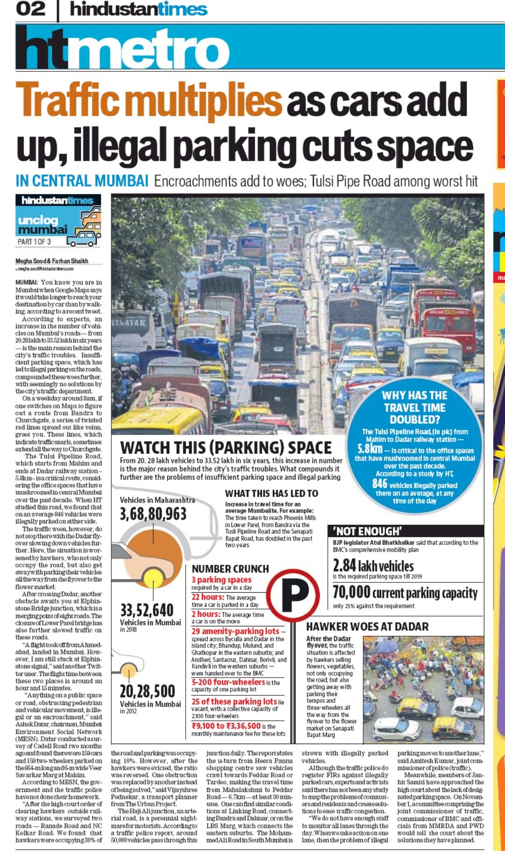
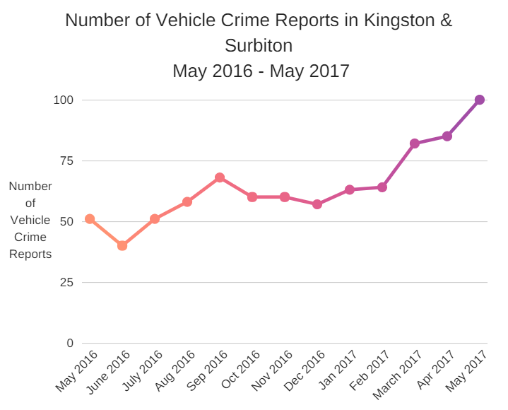
MOTIVATION

Slide 7
PRE-REQUISITES
Python
HTML
CSS
MySQL
NumPy
OpenCV
Tesseract

Slide 8
OpenCV
OpenCV is the huge open-source library for the computer vision, machine learning, and image processing and now it plays a major role in real-time operation which is very important in today’s systems. By using it, one can process images and videos to identify objects, faces, or even handwriting of a human. When it is integrated with various libraries, such as NumPy, python is capable of processing the OpenCV array structure for analysis. To Identify image pattern and its various features we use vector space and perform mathematical operations on these features.
OpenCV Functionality
Image/video I/O, processing, display
Object/feature detection
Geometry-based monocular or stereo computer vision
Computational photography
Machine learning & clustering
CUDA acceleration

Slide 9
Applications of OpenCV: There are lots of applications which are solved using OpenCV, some of them are listed below
Face recognition
Automated inspection and surveillance
number of people – count (foot traffic in a mall, etc)
Vehicle counting on highways along with their speeds
Interactive art installations
Anomaly (defect) detection in the manufacturing process (the odd defective products)
Street view image stitching
Video/image search and retrieval
Robot and driver-less car navigation and control
Object recognition
Medical image analysis
Movies – 3D structure from motion
TV Channels advertisement recognition

Slide 10
IMAGE PROCESSING
Image processing is a method to perform some operations on an image, in order to get an enhanced image and or to extract some useful information from it. If we talk about the basic definition of image processing then “Image processing is the analysis and manipulation of a digitized image, especially in order to improve its quality”.
Digital-Image: An image may be defined as a two-dimensional function f(x, y), where x and y are spatial(plane) coordinates, and the amplitude of any pair of coordinates (x, y) is called the intensity or grey level of the image at that point. In another word an image is nothing more than a two-dimensional matrix (3-D in case of coloured images) which is defined by the mathematical function f(x, y) at any point is giving the pixel value at that point of an image, the pixel value describes how bright that pixel is, and what colour it should be. Image processing is basically signal processing in which input is an image and output is image or characteristics according to requirement associated with that image.

Slide 11
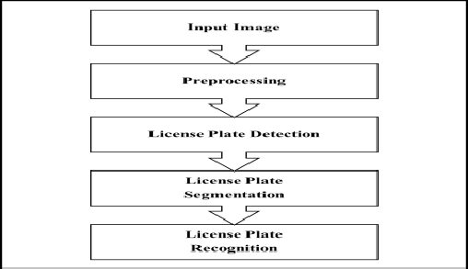
METHODOLOGY

Slide 12
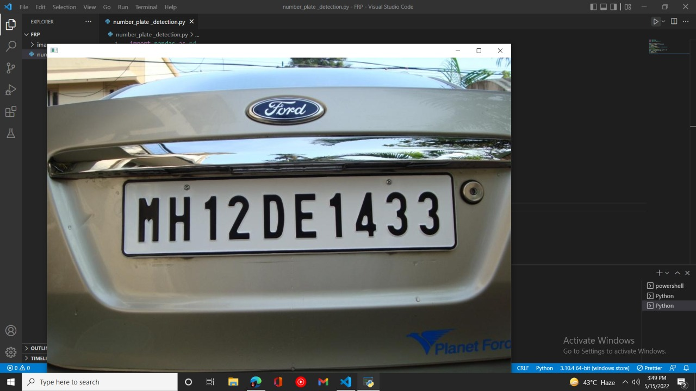
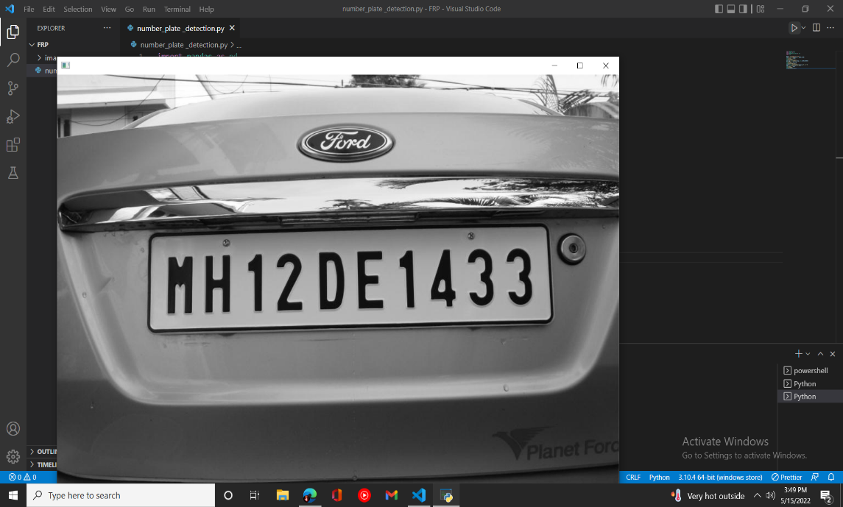
Rgb to grayscale image

Slide 13

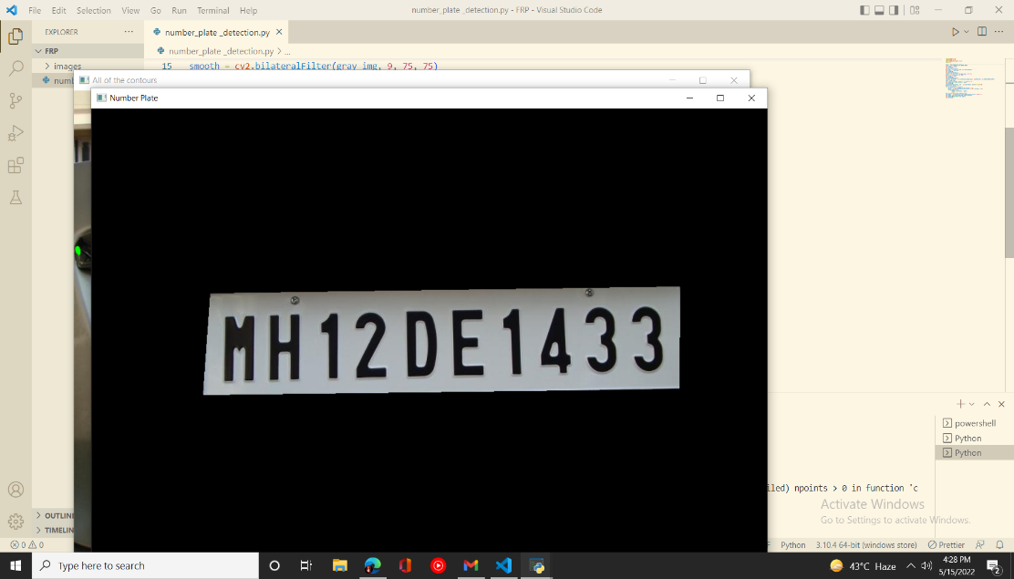
Edge detection
and
number plate localization

Slide 14
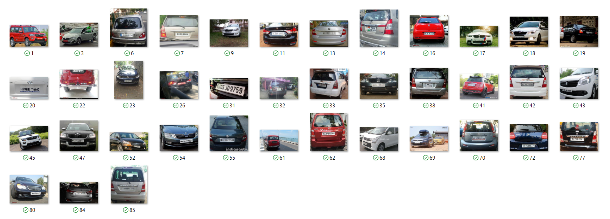
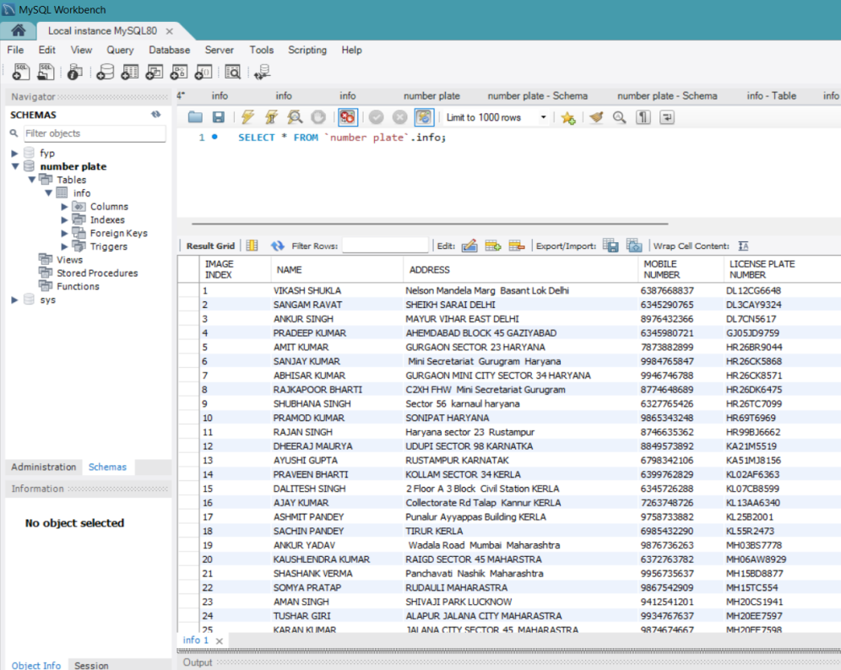
DATASET
We have prepared a dataset of vehicle images and have fed the data of the owner of that vehicle .
The database contains Name, address, mobile number and license plate of the vehicle’s owner.

Slide 15
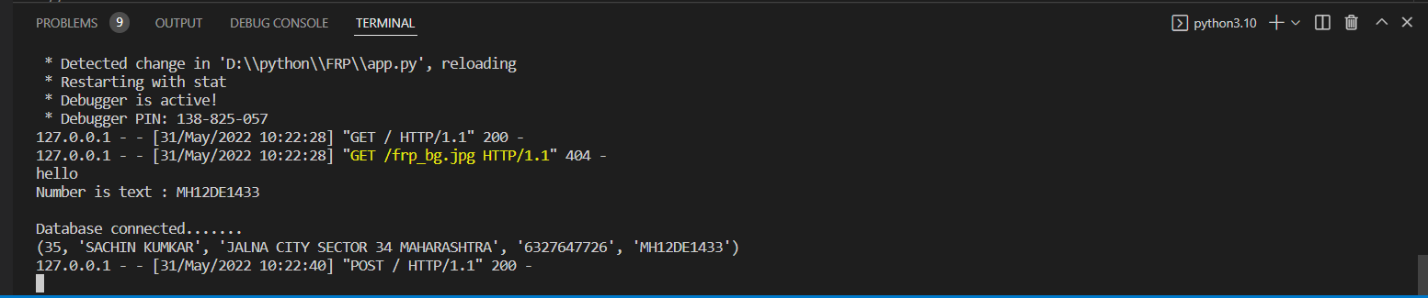
Conclusion
A license plate detection and recognition system is proposed in this project. The proposed system included two stages: the license plate detection stage and the character recognition stage.
After recognition stage if the acquired data matches with that present in the database then the vehicle owner’s information is fetched and displayed, otherwise ‘license plate unidentified’ is displayed.
The experiment results are satisfied and encouraging and show the efficiency of the proposed system.

Slide 16
REFERENCES
[1] Amr Badr, Mohamed M. Abdelwahab, Ahmed M. Thabet, and Ahmed M. Abdelsadek, “Automatic Number Plate Recognition System”, Annals of the University of Craiova, Mathematics and Computer Science Series Volume 38(1), 2011, Pages 62–71 ISSN:1223- 6934 Special Conference Issue: National Conference on Cloud Computing & Big Data 89
[2] J.-W. Hsieh, S.-H. Yu and S.-H. Yu, Morphology-based License Plate Detection from Complex Scenes, IEEE Proceedings of the 16th International Conference on Pattern Recognition, Qubec City, Canada, August 11- 15, 2002, Vol. 3 (2002), 176-179
[3] Choudhury A. Rahman, WaelBadawy, Ahmad Radmanesh, “A Real Time Vehicle’s Number Plate Recognition System ”, Proceedings of the IEEE Conference on Advanced Video and Signal Based Surveillance (AVSS’03)0-7695-1971 ,2003 IEEE Harish D. Kendre,Gaurav V. Talokar, Mohan Girhe, Tejas Pidkalwar, “ The Automatic Number Plate Recognition System (ANPR)”, INTERNATIONAL JOURNAL OF MATHEMATICS AND COMPUTER RESEARCH, Volume 1 issue 3 April 2013 ISSN :2320-7167, pp. 99-102
[4] Sourav Roy, Amitava Choudhury, Joydeep Mukherjee, “An Approach towards Detection of Indian Number Plate from Vehicle”, International Journal of Innovative Technology and Exploring Engineering (IJITEE) ISSN: 2278-3075, Volume-2, Issue-4, March 2013.

Slide 17
THANK YOU

